Slide 1
EPC-24-031 - Green Construct Charge (GCC): Grid-Supportive Mobile Charging Stations for the Electrification and Decarbonization of Construction Electric Vehicles: CPR 1 meeting
Presenters: Yuanyuan Shi (PI), Avik Ghosh, Keaton Chia, Mike Ferry, Sasha Doppelt
Electrical and Computer Engineering, UC San Diego
March 5th, 2026
Notes:
Logo sunbelt

Slide 2
Agenda
Welcome and Introductions- Yuanyuan Shi (5 min)
Introductions: Name, role, organization
Project Overview- Yuanyuan Shi (5 min)
Project Goals and Objectives
Project Updates- (35 min)
Optimization Framework- Avik Ghosh (10 min)
Demonstration and and Data Analytics- Avik Ghosh (5 min)
MCS-To-Grid Optimization and Demonstration During Emergency Situations- Keaton Chia (5 min)
Challenges & Lessons learned so far- Avik Ghosh & Mike Ferry (10 min)
Administrative Update- Sasha Doppelt (5 min)
Discussion and Q&A roundtable (15 min)
Administrative business- (30 min)

Slide 3
PROJECT GOAL
California Energy Commission (CEC) grant to demonstrate the feasibility and value of mobile charging stations for charging of construction electric vehicles

Slide 4
BACKGROUND
Construction equipment annually produces about 400 metric tons of CO2, accounting for roughly 1.1% of global emissions
Construction industry is linked to the highest number of occupational cancer cases annually, with approximately 8% attributable to diesel exhaust emissions
Electrifying construction equipment is crucial to reduce carbon emissions and air pollutants, and aiding global climate goals
https://www.idtechex.com/en/research-article/electric-construction-machines-vital-for-greener-construction/26187

Slide 5
EXISTING CHARGING SOLUTIONS AND CHALLENGES
Charging construction electric vehicles (CEVs) at existing fixed charging stations (FCSs) is limited by their low mobility and can obstruct traffic and raise safety concerns
While installing on-site charging facilities for CEVs during construction is an option, it entails substantial capital investment and prolonged permitting procedures
Notes:
However, the shift to construction electric vehicles (CEVs) demands significant investments in charging infrastructure. Moreover, the high charging power required by CEVs intensifies peak demand, necessitating costly distribution grid upgrades.

Slide 6
INNOVATION: Mobile Charging Solution for CEVs
Develop advanced optimization to optimize the charging schedule of CEVs and recharging locations/schedules of MCSs
Develop novel machine learning to understand the energy consumption patterns and charging demand of CEVs
Achieve reduced carbon emissions, reduced charging time and costs, and peak power reduction compared to competing technologies: construction equipment with internal combustion engines and charging CEVs with fixed charging stations

Slide 7
KEY TECHNICAL TASKS FOR THE PROJECT
Task 2: Optimization framework for the MCS-CEV charging/discharging
Task 3: Installation, Data Analytics, and Modeling of MCSs and CEVs
Task 4: MCS-CEV Testing and Demonstration
Task 5: MCS-To-Grid Optimization and Demonstration During Emergency Situations

Slide 8
Task 2: Optimization framework for the MCS-CEV charging/discharging

Slide 9
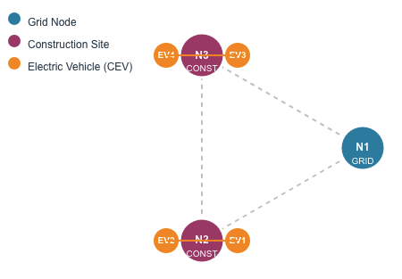
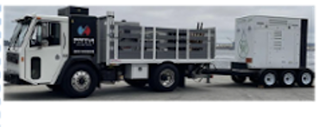
NETWORK TOPOLOGY
MCS 2
MCS 1
Notes:
CEVs cannot move in between sites; only MCS charges from the grid; Add MCS simulation

Slide 10
NETWORK TOPOLOGY
MCS 2
MCS 1

Slide 11
OPTIMIZATION FRAMEWORK
APPROACH
INPUTS
Calculate MCS charging power considering CEV energy demand, travel, electricity and carbon emission prices
Dispatch MCS to construction sites by selecting MCS location and departure/arrival times
OUTPUTS
CEV Data
MCS Data
FCS Data
Electricity price
Carbon emissions
Optimal MCS-CEV operation
Minimum electricity costs and carbon emissions
Peak load reduction
Return MCSs to grid nodes for recharging
Charge CEVs and manage their operations based on their working schedule

Slide 12
OPTIMIZATION FORMULATION
Objective function
Constraints
Charging/Discharging power constraints of MCSs/CEVs
Energy consumption and state of energy constraints of MCS and CEVs
Spatial movement and connection status constraints of MCS
When, where and by how much to work with CEVs
Carbon emissions
Electricity costs
Peak demand charges
Penalty for missed work
When, where and by how much to charge/discharge MCS

Slide 13
CASE STUDY: Operation Strategies
Operation Strategy | FCS present | MCS present | MCS optimally scheduling
Using ICE-powered construction vehicles | No | No | N/A
Charging the CEVs directly from the grid through FCS - No MCS | Yes | No | N/A
Charging the CEVs from the MCSs without optimal scheduling | No | Yes | No
Charging the CEVs from the MCS with the proposed optimization framework (Ours) | No | Yes | Yes

Slide 14
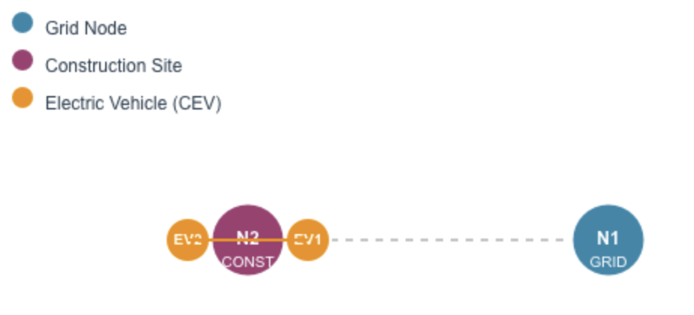
CASE STUDY: Topology for the scenarios
Scenario 1: 1 site; 2 CEVs; 1 MCS
Scenario 2: 2 sites; 4 CEVs; 2 MCSs
MCS 2
MCS 1
Similar setup to the 1st phase demonstration @ UCSD
MCS 1
CEV 1: Electric mini excavator (JCB 19C-1E); CEV 2: Electric telehandler (JCB 505-20E)
CEV 3: Electric compact excavator (Volvo ECR25); CEV 4: Electric wheel loader (Volvo L20 electric)
MCS 1 and 2: Saniset J250
Notes:
Tech specs

Slide 15
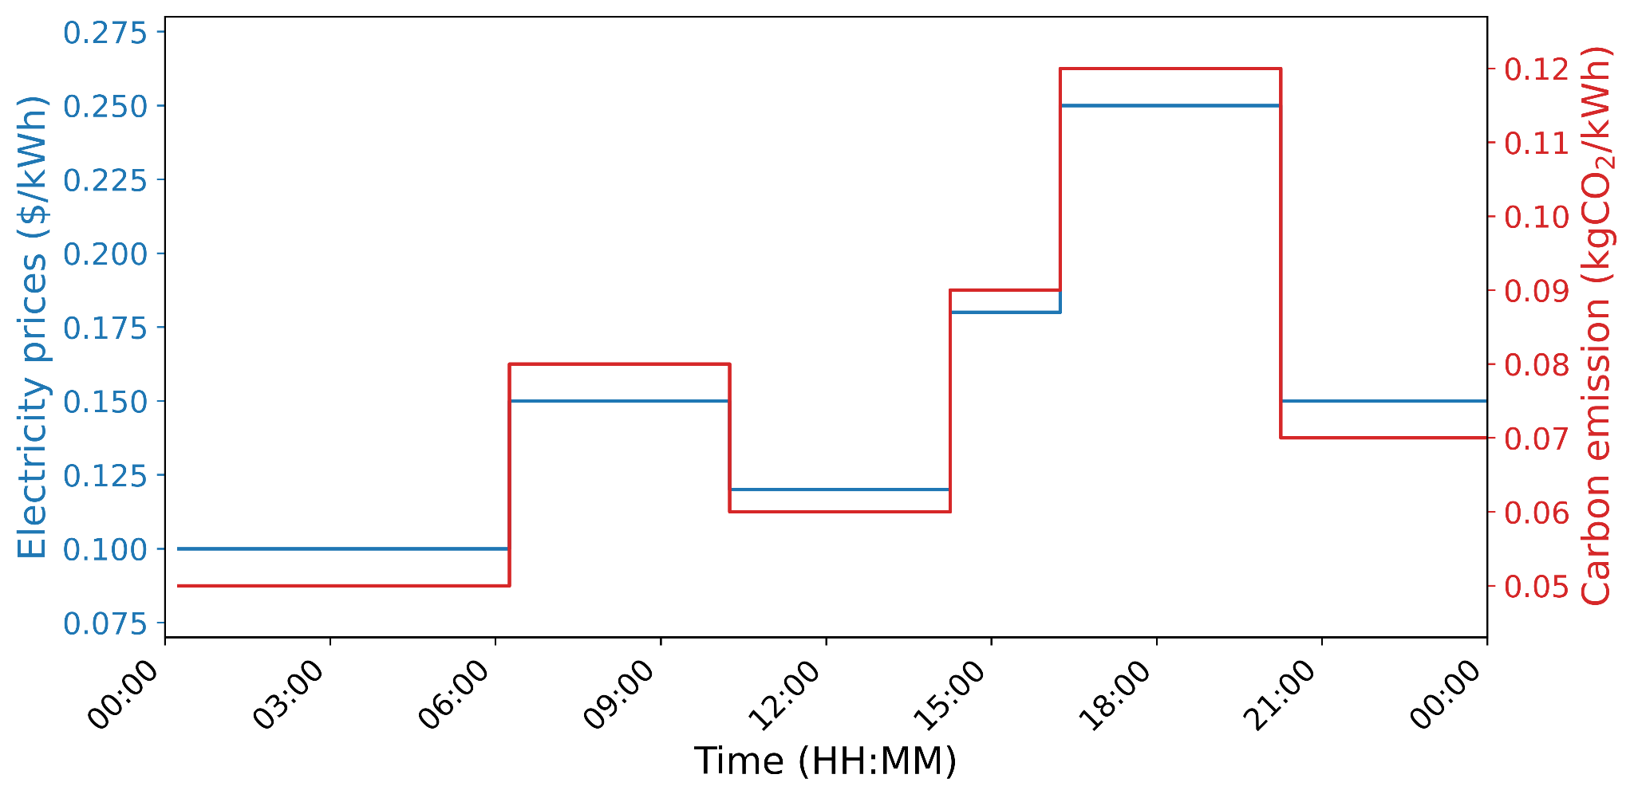
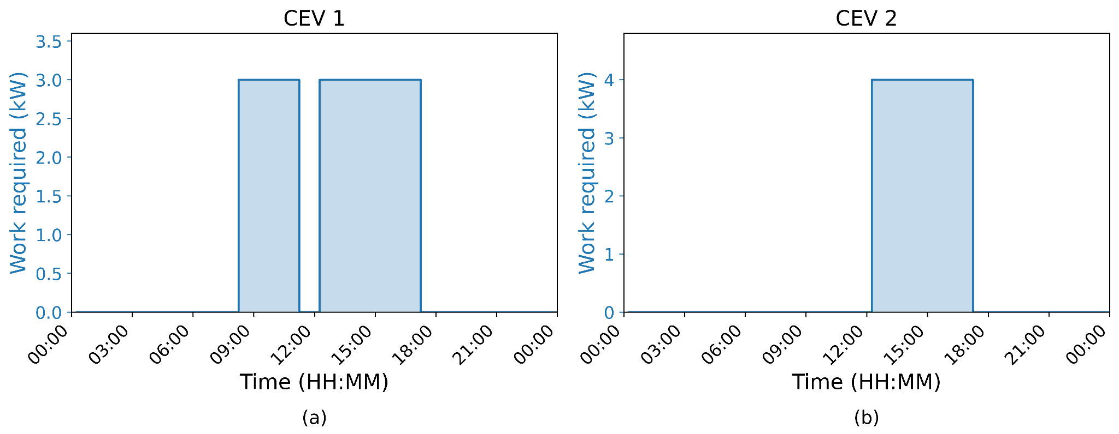
CASE STUDY: Input Data
Working schedules of CEVs
Electricity rate and carbon emissions
Notes:
Hypothetical - give context

Slide 16
CASE STUDY: Results
Operation strategy | CO₂ emissions (kg) | Energy cost ($) | Peak demand (kW) | Missed work (kWh)
A (ICE) | 30.26 | 14.74 | NA | 0
B (FCS without MCS) | 4.75 | 9.86 | 16.80 | 0
C (MCS but not optimal) | 4.73 | 9.95 | 105 | 0
D (MCS and Optimal) | 3.55 | 7.5 | 9.18 | 0
- 84%
- 33%
- 88%
- 49%
- 45%
84-88% drop in CO₂ emissions for CEVs as compared to ICE equipment (Goal: 50% reduction)
33-49% drop in electricity prices for CEVs as compared to ICE equipment
45% drop in peak demand for optimal MCS charging as compared to FCS (Goal: 10% reduction)
0-75% drop in travel times for MCS as compared to CEVs. (Goal 10% reduction)
Going from strategy C to D:
25% drop in CO₂ emissions and energy costs
91% drop in peak demand
Notes:
Compare C and D in a bullet point; next slide for the softer

Slide 17
CASE STUDY: Other Results
1-13% drop in noise levels at the operator station for CEVs as compared to ICE equipment
6-14% drop in noise levels externally for CEVs as compared to ICE equipment
$20k-$200k avoided additional charging infrastructure investments (buying L2/DCFC chargers, installation, etc.) for MCS as compared to FCS.

Slide 18
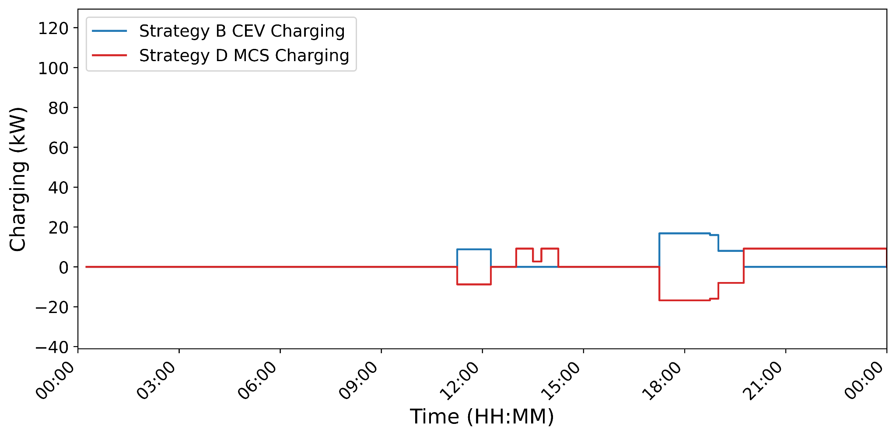
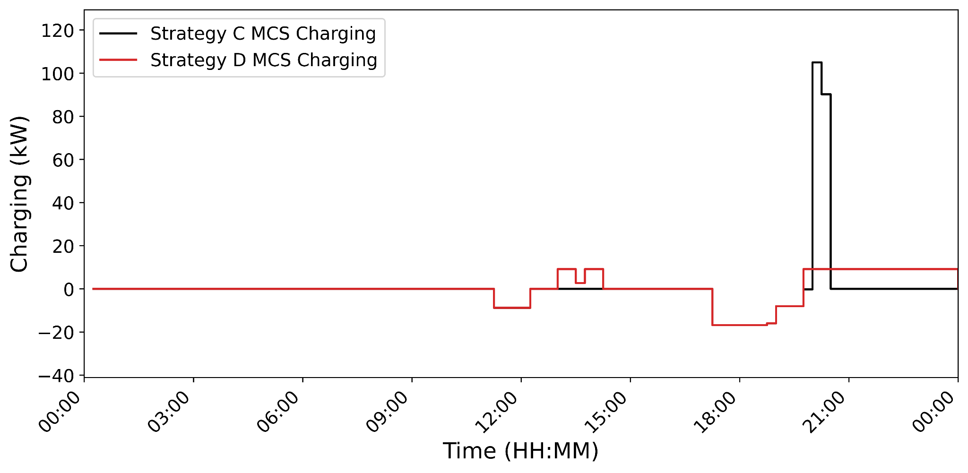
CASE STUDY: Timeseries of MCS/CEV charging
MCS recharging while CEV
working
Strategy B (FCS without MCS)
Strategy C (MCS but not optimal)
Strategy D (MCS and Optimal)
16.8 KW
9.2 KW
CEV lunchtime opportunity charging
105 KW
CEV charging post work
9.2 KW
Notes:
B vs D, C vs D

Slide 19
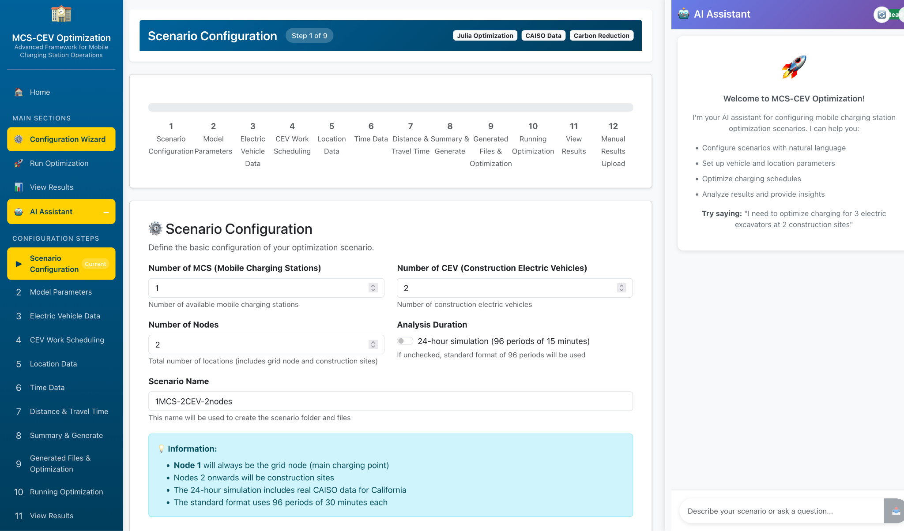
MCS-CEV Optimization Software
https://derconnect.ucsd.edu/greenconstruct/
Notes:
software

Slide 20
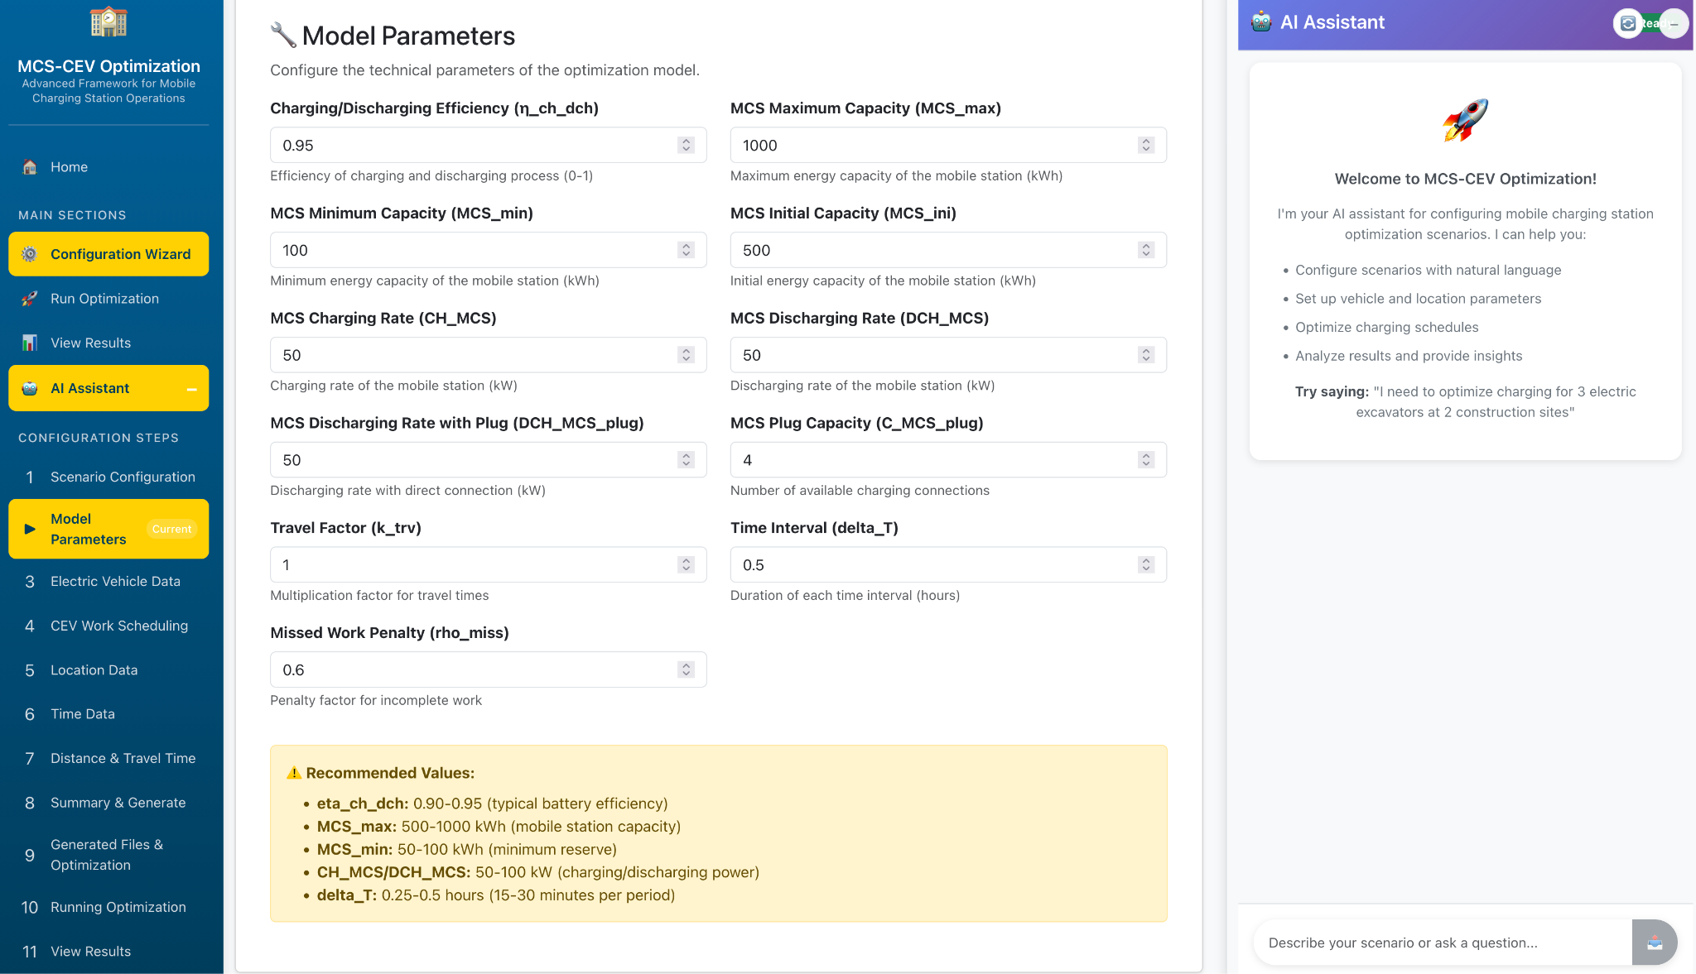
MCS-CEV Optimization Software
https://derconnect.ucsd.edu/greenconstruct/

Slide 21
Task 3: Installation, Data Analytics, and Modeling of MCSs and CEVs
Task 4: MCS-CEV Testing and Demonstration

Slide 22
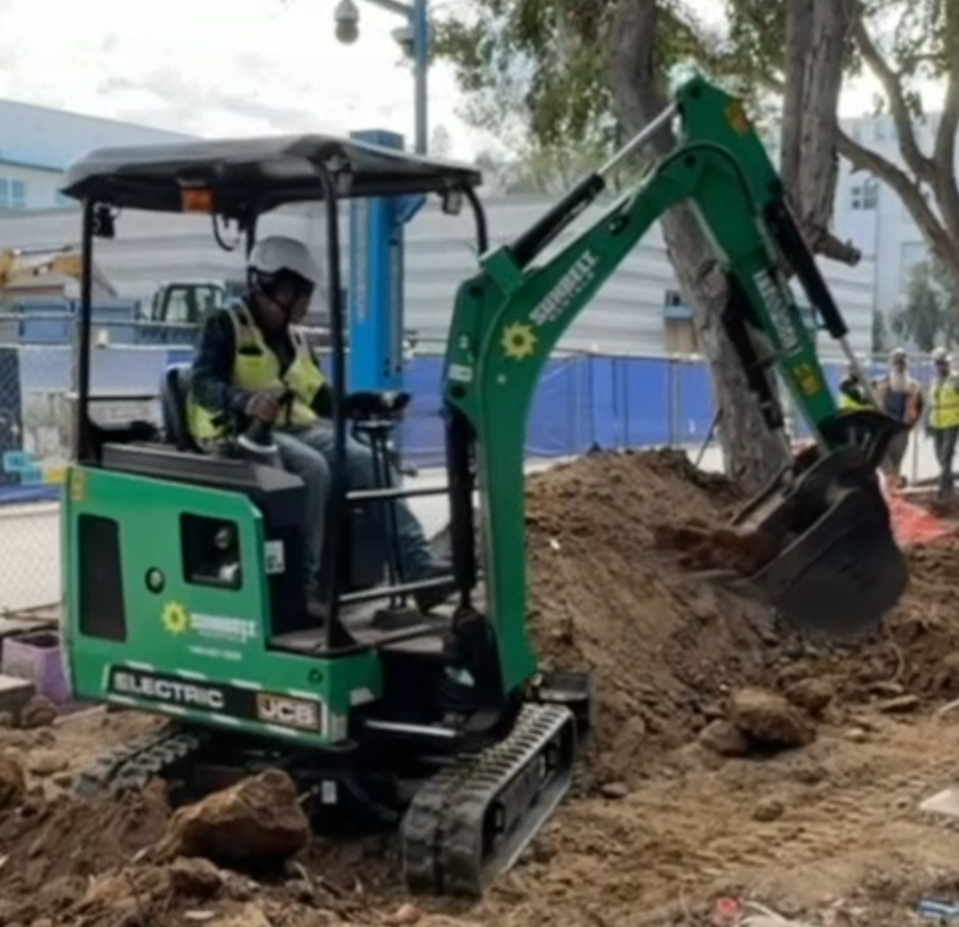
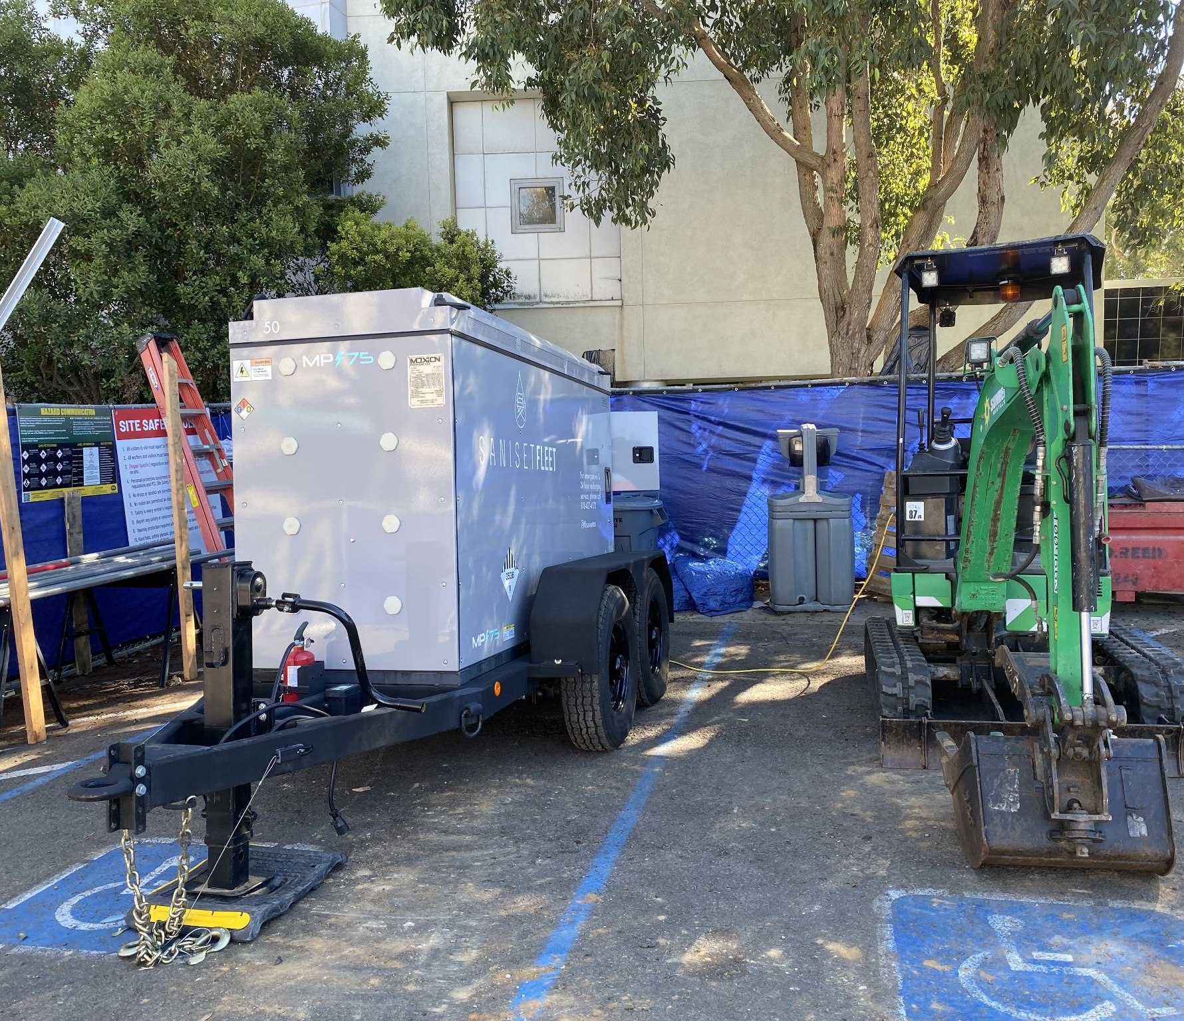
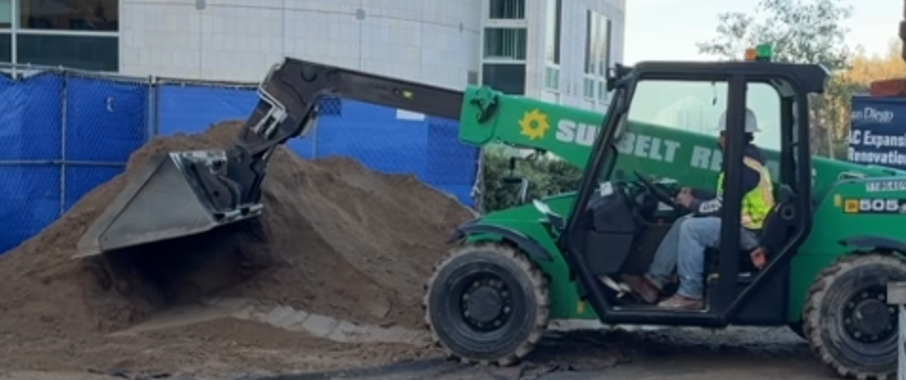
DEMONSTRATION AT UCSD
Completed one phase of demonstration of CEVs performing regular construction activity at the RIMAC gym site at UCSD with recharging from an MCS
1 week in October 2025, and 2 weeks in February 2026 - Equipment rented from Sunbelt Rentals
JCB electric telehandler:
JCB 505-20E
Moxion MP-75 600 kWh MCS recharging the mini excavator
JCB mini electric excavator: JCB 19C-1E

Slide 23
DATA ANALYTICS OF CEVs
Total 34 hours of video recording of construction activities
Time series of state of charge data for the mini excavator and telehandler were shared through inbuilt JCB Livelink telematics
Identified 5 distinct excavator subactivities: digging, loading, swinging, idling, traveling
Manually labeled 4 hours of video recording to identify power consumption of the different subactivities
Currently developing an ML model for automating excavator subactivity identification from the videos directly

Slide 24
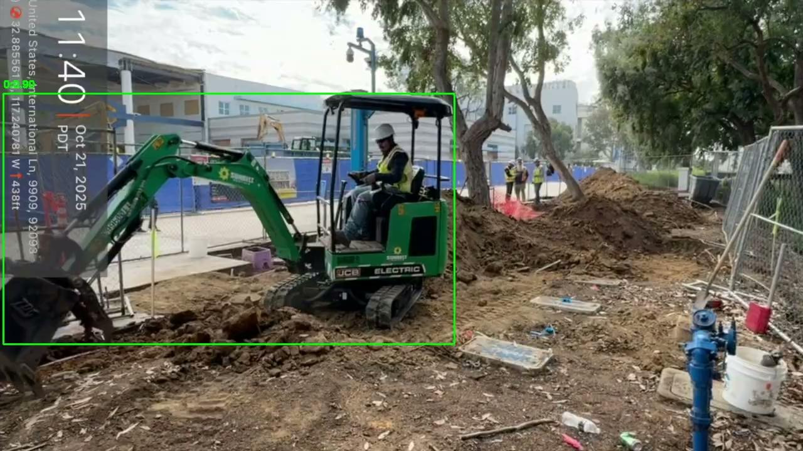
VIDEO ANALYSIS OF THE EXCAVATOR
3 most important activities identified here: digging, loading, swinging

Slide 25
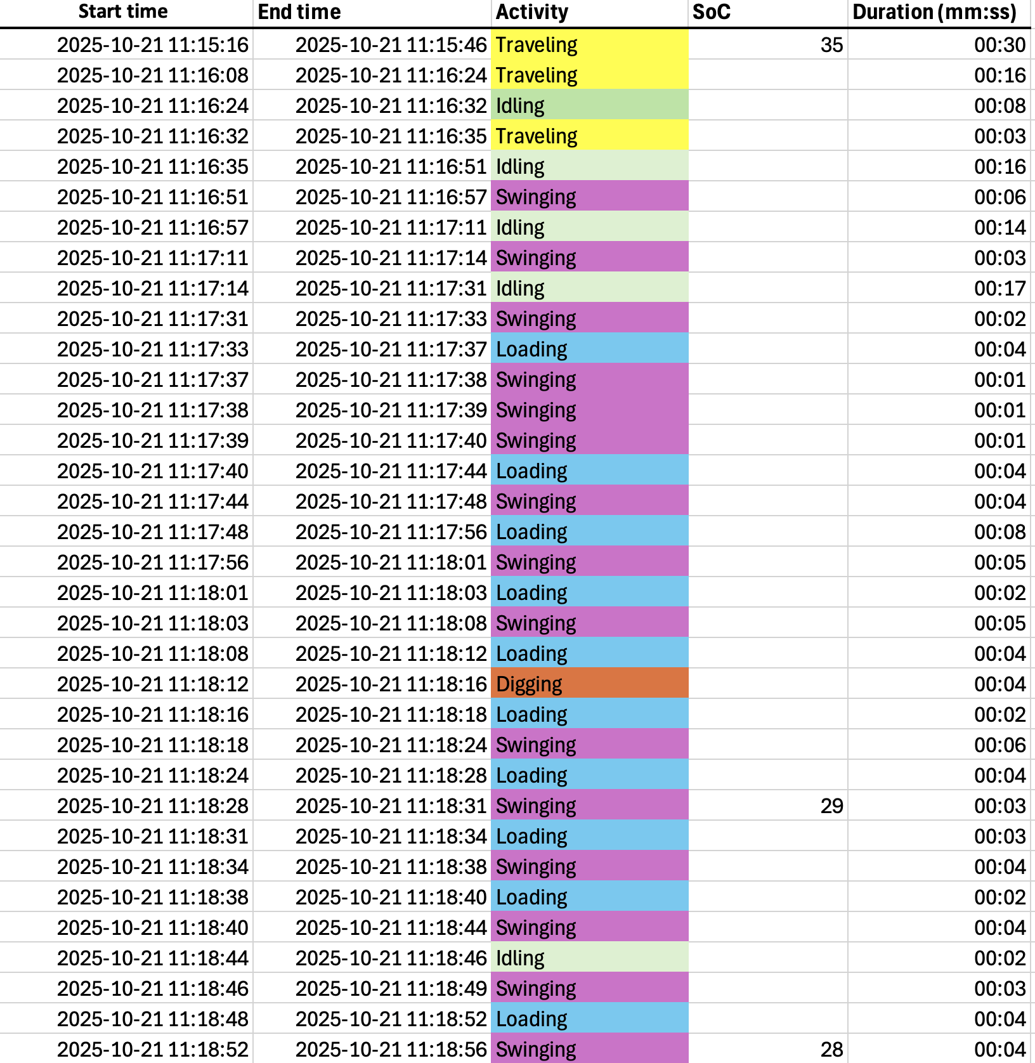
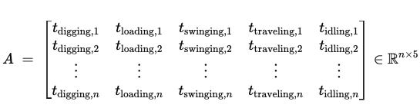
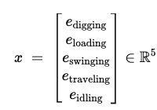
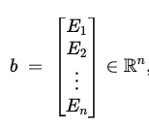


METHODOLOGY FOR SUBACTIVITY POWER CONSUMPTION
Aligning video recording with SOC telematics
Power consumption (to find out)
Time spent on different subactivities for each SOC change
State of energy change corresponding to SOC change
SOC change
Find by non-negative least squares, i.e., minimizing residual:
Digging: 3.9 kW; Loading: 16.0 kW; Swinging: 0.6 kW; Traveling: 7.5 kW; Idling: 0 kW

Slide 26
Task 5: MCS-To-Grid Optimization and Demonstration During Emergency Situations

Slide 27
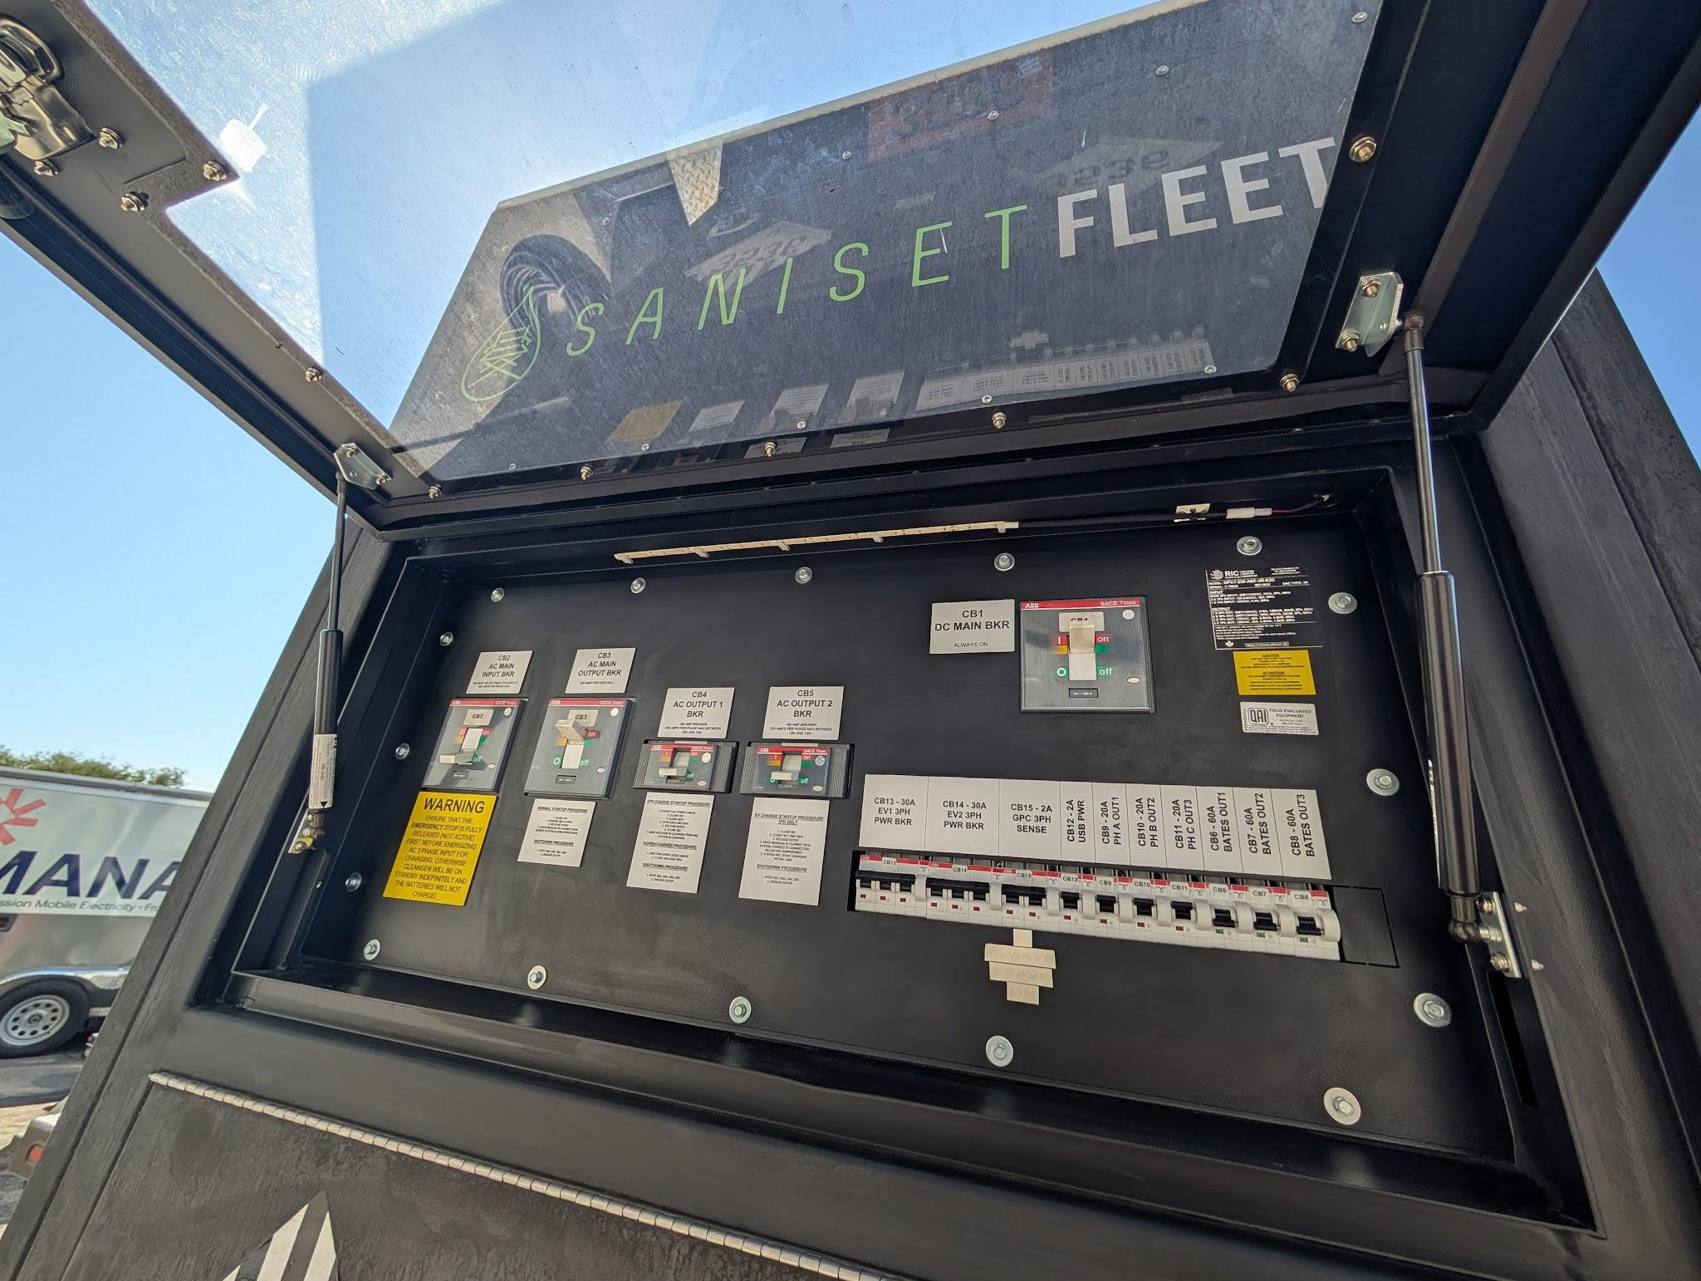
Task 5 Objectives
Battery-to-building application: examine potential benefits of mobile charging stations (MCS) for emergency situations
Produce a Brief of operating strategies of MCSs for emergency building services
Expected Learnings
Building electrical connections
Controls integration
Performance limitations
Operational lessons

Slide 28
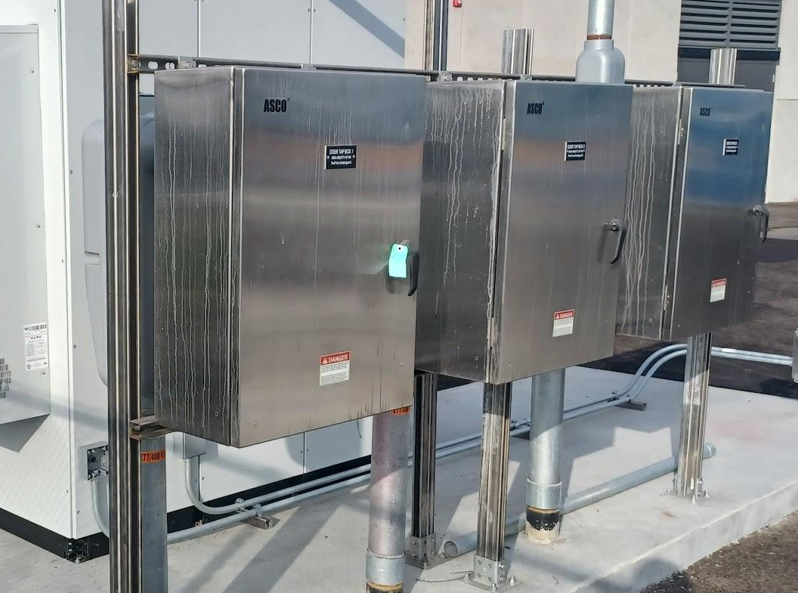
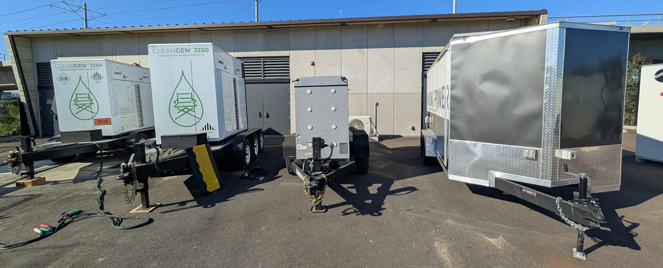
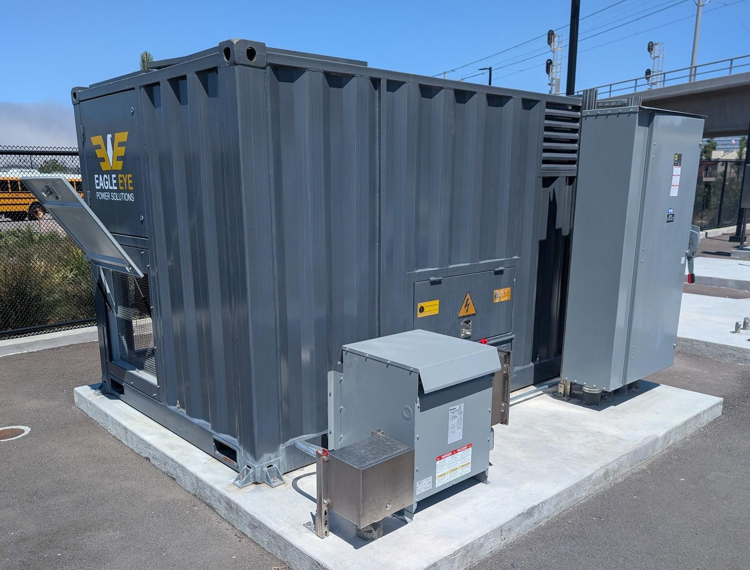
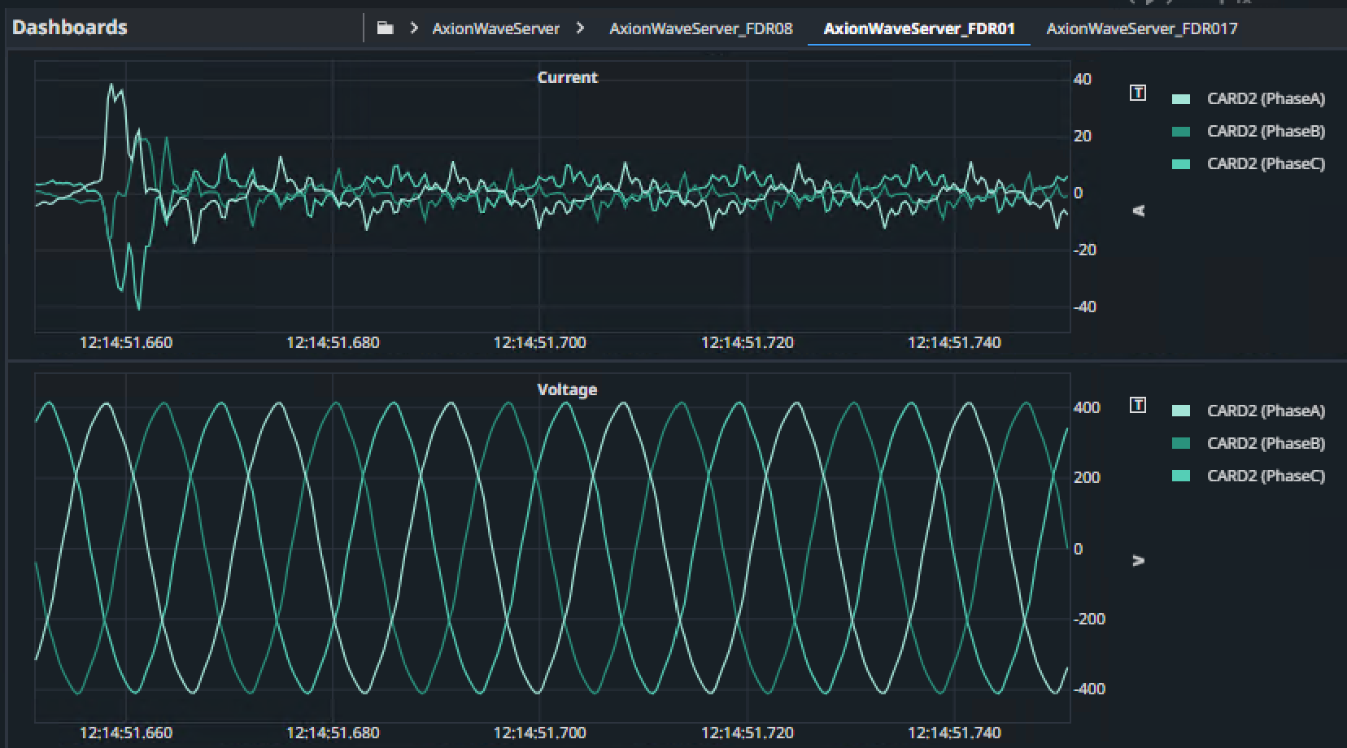
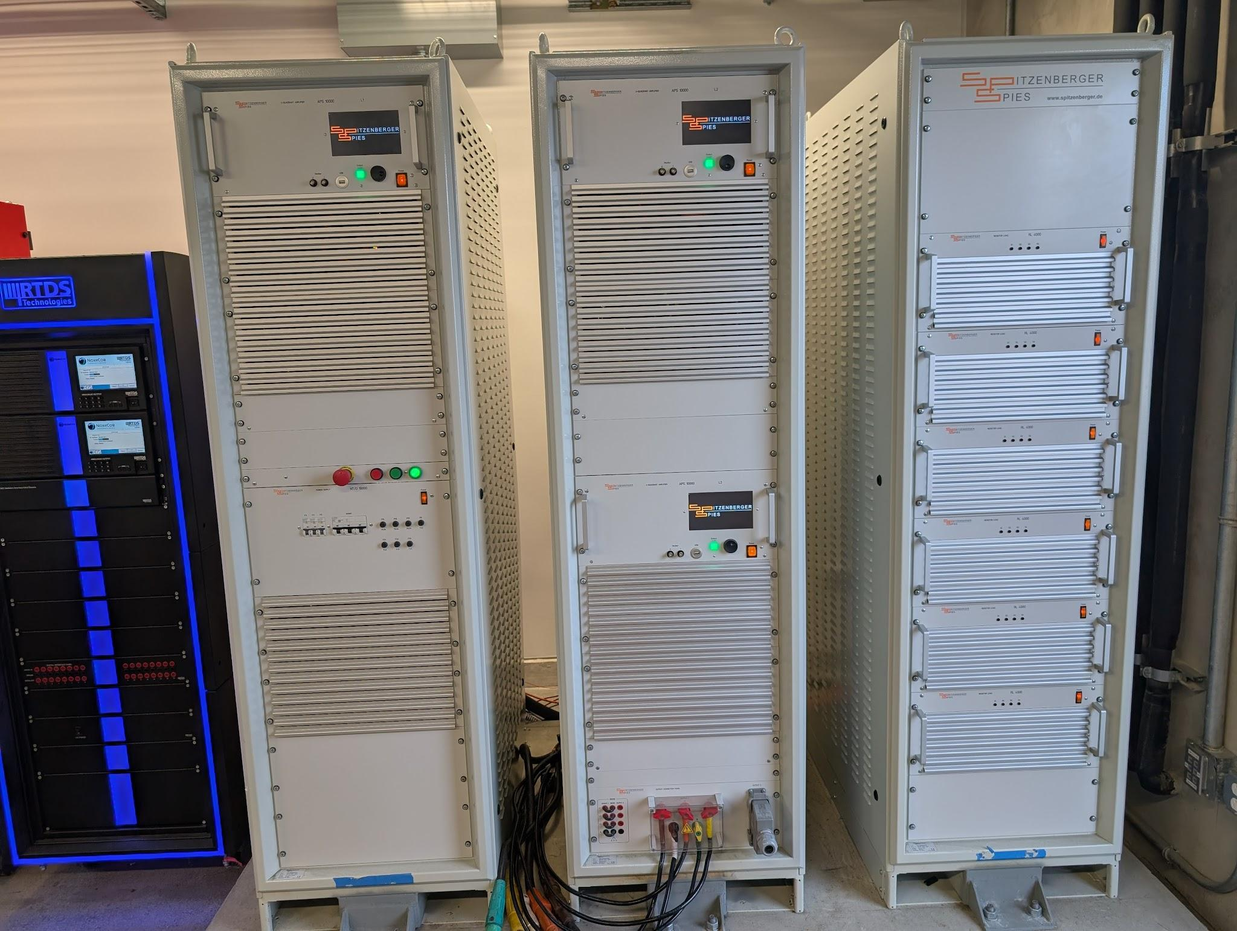
DERConnect Testbed
Mobile batteries
Different inputs/outputs
Mana power, Moxion, CleanGen
Level 2 EV charger
Tap boxes
480V & 208V
Camlock
RLC programmable load bank
Real building load profile
Grid emulator
Phasor and Waveform Data

Slide 29
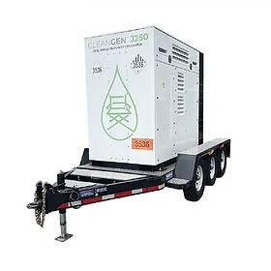
Seamless Grid-to-BESS-to-Grid
Emulated Grid
Scenario:
Building w/ backup battery instead of generator
BESS w/ daisy-chain capability for extended outage
3 hr response time for MCS
J250 w/ pass through
Second J250
Building load

Slide 30
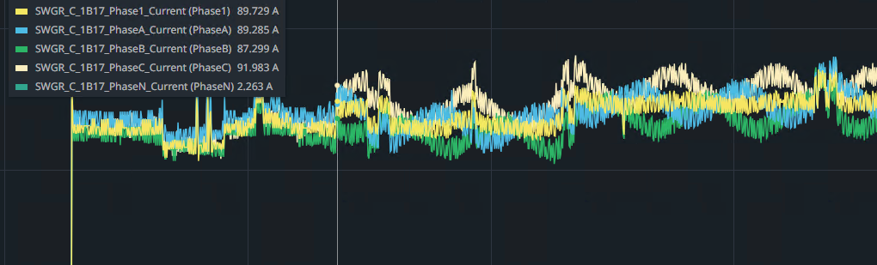
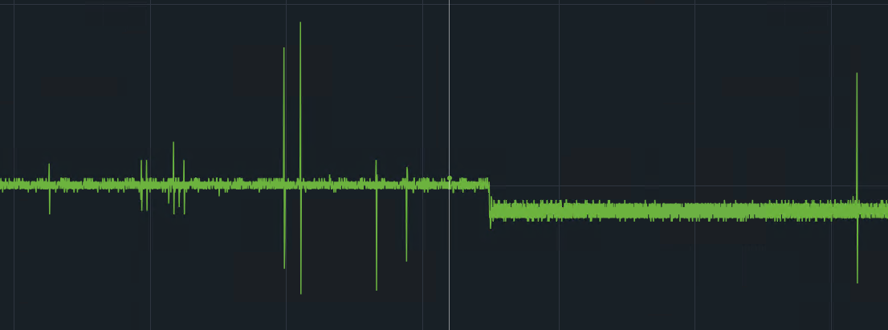
Seamless Grid-to-BESS-to-Grid
Current Magnitude
Scenario:
Results
Seamless transition from and back to grid power
Ran successfully for 8 hr long load profile (emulate working hours)
Seamless transition to and from daisy-chain power
Limitations
MCS not able to do grid-following
Requires automatic transfer switch or daisy-chain/pass-through feature
Frequency
60Hz

Slide 31
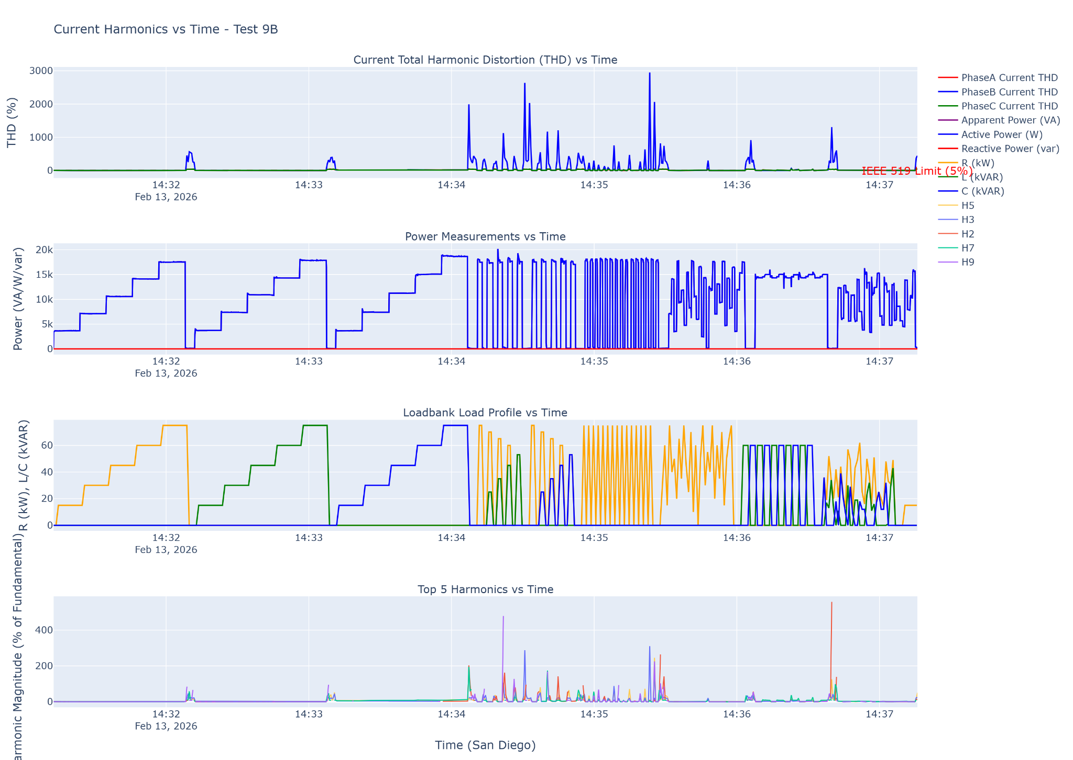
Performance
Characterization
Different power factors
High inductive loads (HVAC)
Harmonics

Slide 32
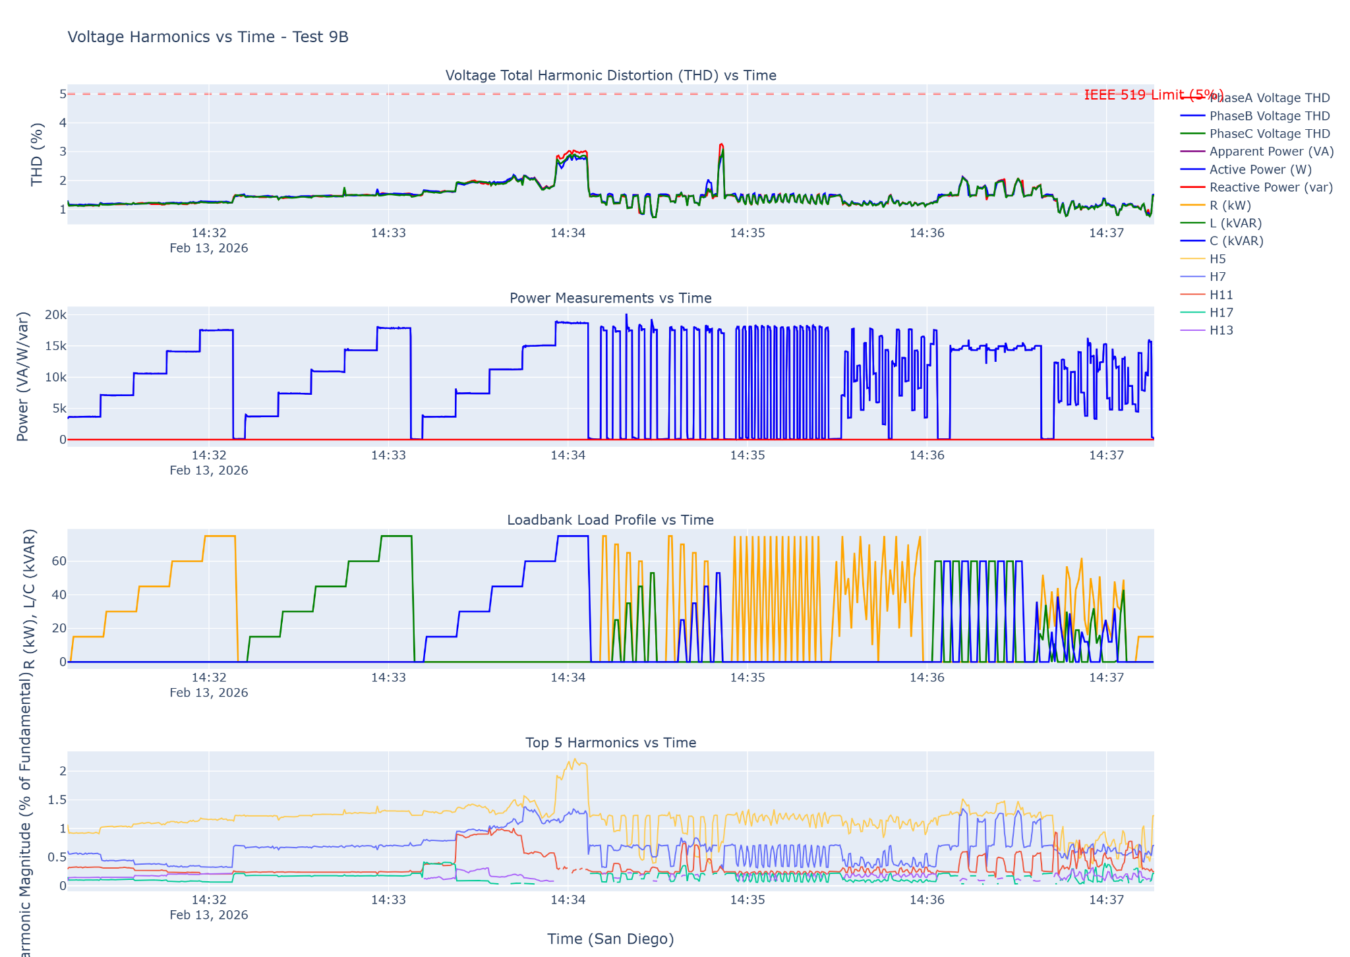
Performance
Characterization
Moxion & CleanGen successfully passed the performance stress tests
Moxion successful in maintaining voltage harmonics below IEEE 519 limit

Slide 33
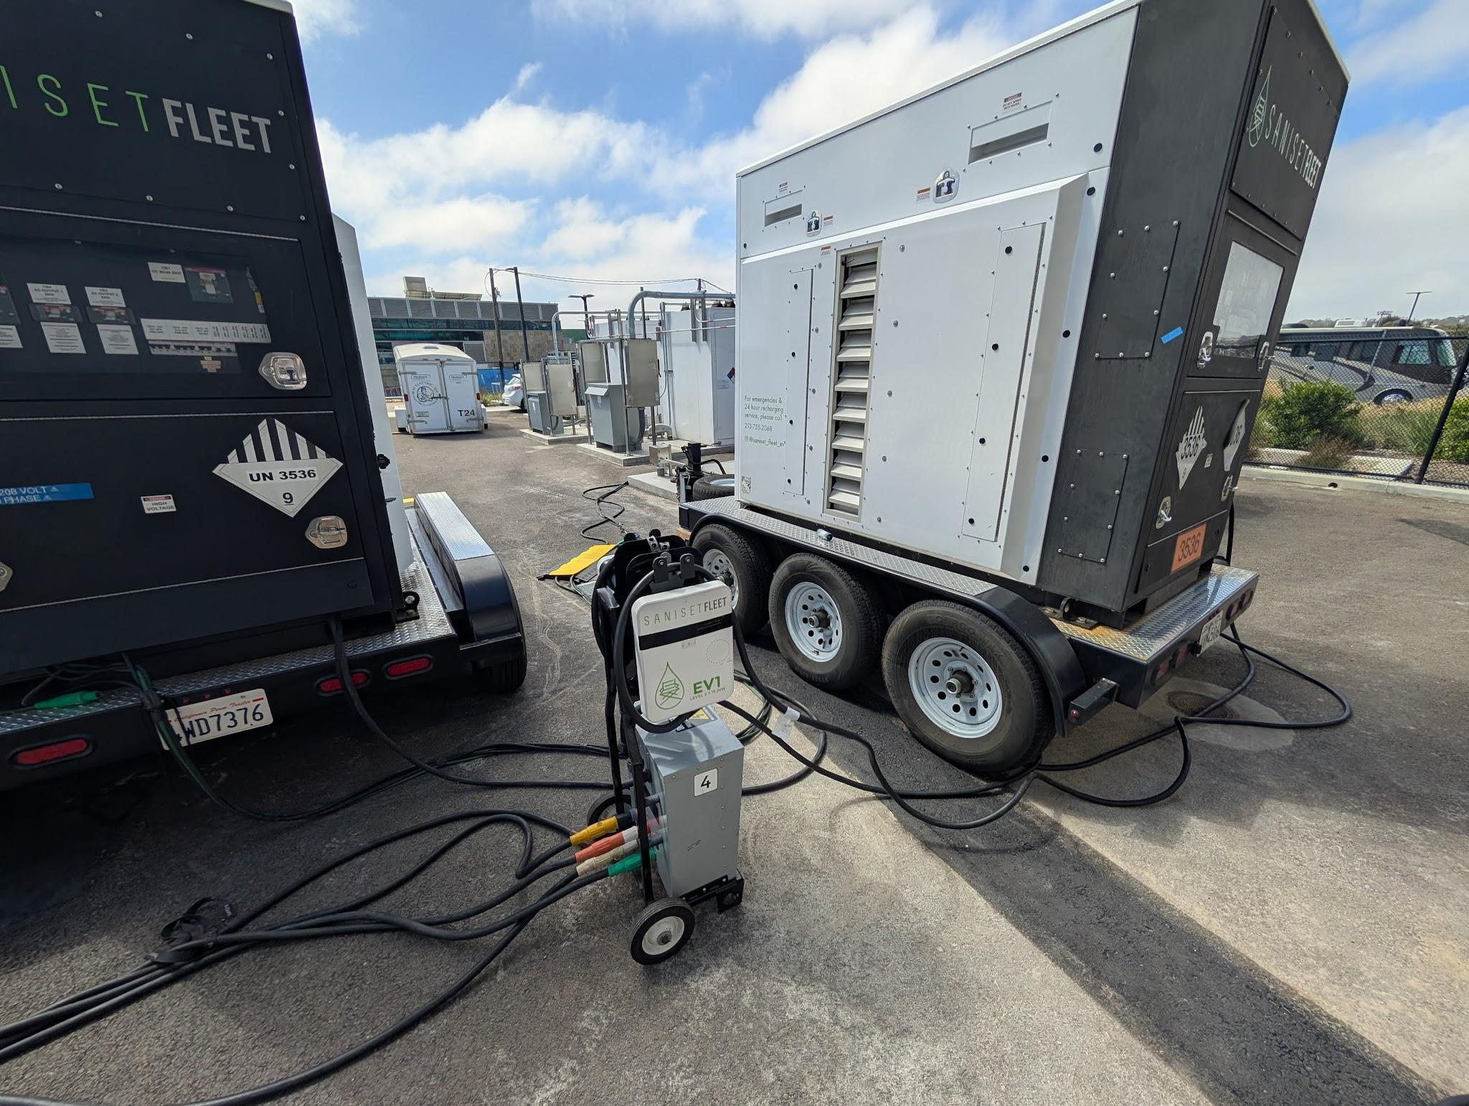
BESS-to-BESS
Scenario:
Building commissioning (e.g. switchgear before real loads)
Uninterruptible power supply - charge while delivering power
Flexibility for energy delivery
Generally successful, but with performance and operational limitations

Slide 34
Operational Lessons
Camlock adapters needed: film industry uses reverse ground
Reliability issues with L2D2 EV charger adapter
Compatibility issues with the L2 chargers inside the Mana Power to charge other BESS. Tried different combinations of charging between BESS units.
Unexpected slow charging using L2D2 with Mana
AC Isolation faults w/ Moxion - potential grounding issues when working with building equipment

Slide 35
Challenges and Lessons Learned

Slide 36
CHALLENGES & SOLUTIONS
Hard to communicate with construction crew: Communicate with GC about the possibility of interacting with a site manager more frequently
No clear construction schedule available a-priori to plan videography: Communicate with GC about the need for a schedule before next phase of construction
Telematics aren’t uniformly granular and may often be unreliable: Collect more data during the other phases of construction
No open source ML based automated subactivity identification model available: Continue building our CNN based model
Construction teams have limited experience with CEVs and (sometimes incorrect) preconceived notions. Proactive education and planning.

Slide 37
LESSONS LEARNED - Data and Modeling
Manual labeling of construction videos very time consuming
Accuracy of ML models in automated subactivity identification from construction videos is moderate

Slide 38
LESSONS LEARNED- Demonstration
Planning and preparation is key for a smooth demonstration
Ask equipment vendor to service electric equipment before delivery
Work with GC to determine best location of MCS on construction site
Have equipment delivered and set up before construction starts to ensure
all equipment works
operators know how to use equipment
the charging cables have the correct adaptors
fast charging is an option from day 1

Slide 39
Administrative Items

Slide 40

Schedule
# | Task | Ahead | On-Schedule | Late
1 | General Project Tasks
2 | Optimization Framework
3 | Installation, Data Analytics, and Modeling of MCSs and CEVs
4 | MCS-To-CEV Testing and Demonstration
5 | MCS-To-Grid Optimization and Demonstration During Emergency Situations
6 | Evaluation of Project Benefits
7 | Technology/Knowledge Transfer Activities

Slide 41
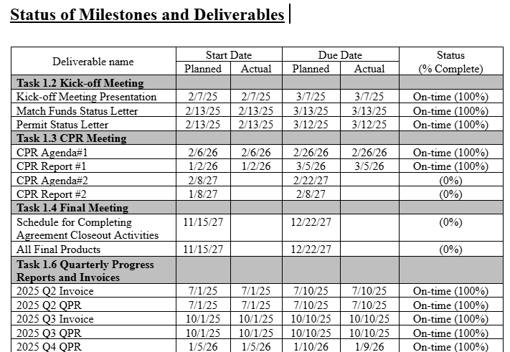
Deliverables
Every deliverable due so far has been submitted
2 early deliverables were late by 1 day
Remaining deliverables have been
submitted on time or early.

Slide 42
Next Steps
Task 3: Installation, Data Analytics, and Modeling of MCSs and CEVs
Continue working with Sunbelt Rentals for collecting a diverse range of telematics data
Continue working on the ML based automated construction subactivity identification model from videos
Use the results from the ML model and telematics to better analyze power consumption of different subactivities
Use the learnings from the construction demos to better plan future constructions
Task 4: MCS-To-CEV Testing and Demonstration
2nd phase of RIMAC demonstration will begin August-Oct 2026
Continuing to identify demonstration sites
Task 5: MCS-To-Grid Optimization and Demonstration During Emergency Situations
Record waveform data from CleanGen J250
Perform grid impact study from construction demonstrations
Complete best practices brief

Slide 43
Q & A

Slide 44
APPENDIX
Notes:
Alignment with EPIC 5

Slide 45
TECHNICAL SPECIFICATIONS OF CEV/MCS
Name of the MCS | Battery energy capacity (kWh) | Charging and discharging efficiencies (%) | Maximum charging/discharging power (kW) | Road energy consumption(kWh/mile) | Noise Level (dB)
Saniset J250 | 250 | 95 | 105/80 | 0.5 | 55
CEV index and type | CEV 1: JCB mini excavator | CEV 2: JCB telescopic handler | CEV 3: Volvo compact excavator | CEV 4: Volvo electric wheel loader
Quantity | 1 | 1 | 1 | 1
Maximum charging power (kW) | 8.8 | 8 | 18 | 15
Battery energy capacity (kWh) | 19.8 | 25 | 40 | 45
Working capacity (kW) | 7 | 6.8 | 15 | 13.7
Site location | 1 | 1 | 2 | 2
Total work requirement (kWh/day) | 24 | 20 | 55 | 35
Noise level at operator Station (dB) | 68 | 75 | 76 | 72
External noise level (dB) | 87 | 93.6 | 80 | 89

Slide 46
CONSTRAINTS
Charging and discharging power constraints of MCS and CEVs:
MCSs charge only at grid nodes, while CEVs charge only at construction sites
MCS and CEV charging/discharging power is limited
An MCS can charge at most 2 CEVs at the same time
CEV power use is limited by its work capacity
CEVs consume power only during working hours
Missed work is the gap between the required CEV power and the actual power used

Slide 47
CONSTRAINTS
2. Energy consumption and state of energy constraints of MCS and CEVs:
The state of energy of MCSs changes with charging, discharging, and travel, accounting for efficiency losses
The state of energy of CEVs changes based on their power consumption and charging
The state of energy of both MCSs and CEVs must remain within minimum and maximum limits
Over a day, MCSs and CEVs must end with the same state of energy with which they started

Slide 48
CONSTRAINTS
3. Spatial movement and connection status constraints of MCS:
An MCS cannot be at multiple nodes at the same time
Travel between nodes must take the required time based on distance and speed
An MCS cannot arrive at and depart from the same node at the same time

Slide 49
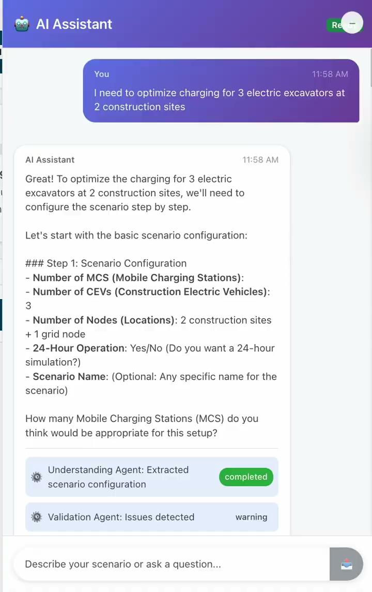
MCS-CEV Optimization Software AI Assistant
Our next step goal was to develop an AI co-pilot to support interaction between users and the MCS-CEV optimization web app to make our toolbox easier accessible to construction site operators:
AI agents interpret construction site charging demand and configure scenarios.
The system generates and explains optimized charging schedules.
The AI module integrates directly with the MCS-CEV web application.
Demo video: AI co-pilot to be developed for assisting construction site with CEV charging and MCS recharging
Notes:
software

